Slide 1


ITC 6000 Database Management Systems Final Project Presentation 2024 Winter Restaurant Management System
Patel Savankumar Hasmukhbhai
Patel.savank@northeastern.edu

Slide 2
Overview
Project Overview
User Persona’s
Business Rules
ER Diagram
Solution Architecture and HA
Major SQL examples
Metrics
Security & Privacy Concerns
Next steps / Lessons learned

Slide 3
Project Overview
RMS makes ordering and dining out smooth for customers and staff.
It manages menus, table bookings, and orders.
Helps staff serve quickly and talk to each other well.
Keeps all restaurant info in one place.
Works for all staff, like managers, chefs, and servers.

Slide 4
Personas
Manager/Administrator:
Handles overall restaurant management using RMS.
Manages menus, schedules, stocks, and reports.
Aims for smooth operations and profit.
2. Waitstaff:
Takes orders, manages tables, and payments with RMS.
Seeks efficient customer service and table turnover.
3. Kitchen Staff:
Prepares food and manages stock using RMS.
Focuses on efficient prep and inventory control.

Slide 5
ER Diagram
Link : ERD of Restaurant Management System
Total 5 tables are therewith their attributes, primary keys and foreign keys.
And I have display the relationship between all tables.

Slide 6
Other Business Rules & Facts
EMPLOYEES are linked to their specific roles and shift schedules.
CUSTOMERS have unique identifiers for placing ORDERS and managing transactions.
ORDERS contain details about the menu items selected and the customers who ordered them.
ITEMS have unique identifiers and include details like name, description, and price.
CATEGORIES organize items on the menu and include additional information like images.

Slide 7
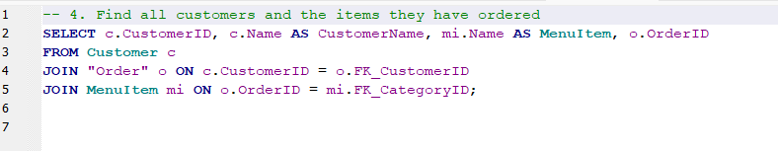
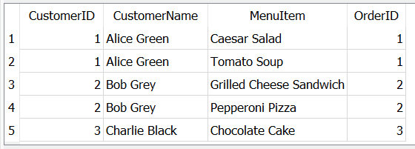
SQL Examples
SQL query intended to find all customers and the items they have ordered by joining tables Customer, Order, and MenuItem on their respective ID fields.

Slide 8
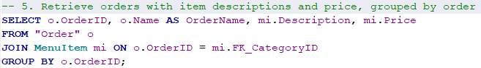
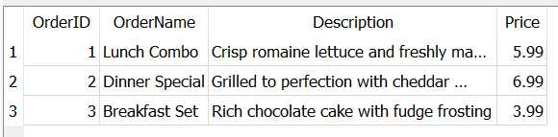
SQL Examples
The SQL query retrieves orders along with item descriptions and prices, grouped by each order ID. The output table displays individual orders identified by an OrderID, each with a name, description, and price.

Slide 9
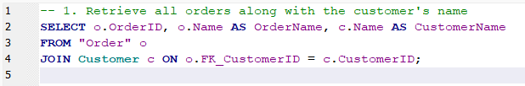
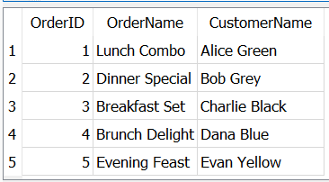
SQL Examples
This SQL query joins customer names to their respective orders. The result is a table listing order IDs, order names, and customer names

Slide 10
Metrics and Analytics
There are total 5 Customer associated with Restaurant.
We've got a range of orders from the "Lunch Combo" for Alice Green to the "Evening Feast" for Evan Yellow, showcasing our diverse menu offerings.
Our menu spans various categories with favorites like the "Caesar Salad" in Starters to "Chocolate Cake" in Desserts, with prices ranging from $3.99 to $8.99, catering to different tastes and budgets.
Grouping orders by item details, such as the "Lunch Combo" with crisp romaine lettuce, allows us to track our bestselling dishes and their prices, which is essential for menu planning and pricing strategy.

Slide 11
Security and Privacy
Our RMS stores private details like employee and customer names, contact info, and orders.
If the wrong person gets this info, it could lead to problems like identity theft.
We make sure only authorized people can access this data, and we keep it secure online and offline.
Regular checks on our system help prevent any security issues.

Slide 12
Next steps / Lessons Learned
Improved skills in understanding restaurant operations and user needs.
Learned to map out how different parts of the RMS connect using diagrams.
Focused on making the RMS better and ready to handle more work.
Learned the importance of keeping customer and staff data safe.
Planning to add new features like tracking orders and managing tables better.

Slide 13
Any Questions?

Slide 14
Thank You!!

